Slide 1
Pet Store Database
CSCI 4370 (Database Management)
Fall 2021
Group 4
Reese Mallory, Kalyb Sanders, Joseph Nguyen, and Avranil Basu

Slide 2
Problem and Motivation
The problem that we set out to overcome is to create an ecommerce web store where users can add products to their cart and checkout. This is very similar to almost all online web stores used today, so we wanted to implement something similar.
Our motivation for this is project is to implement the web store in a way similar to how most enterprise businesses set up their web stores. This means trying to include features that some online stores use, such as store multiple cards per user, and more.
Notes:
Reese

Slide 3
Project Description
Our Project is defining a basic online shopping system in the form of a pet supplies store. This pet store should include different functions such as editing product details, editing payment types, editing user information, querying a products list, adding to a cart, and more
Our client in this case is a business that needs to track its products, as well as allow users to query and purchase items from the database. The users for this database in this case is both customers(normal users) and the business/employees(admins).
Some Examples of queries needed are :
Query all products based on search term
Allow the user to change information of their account
Query all past transactions/orders
Notes:
Reese

Slide 4
How the work as divided
Work was divided evenly once we determined which forms we were going to use. Once we determined which forms needed to be created, each person was assigned a portion of the forms to complete.
Once the forms were completed, we set up a meeting where we could implement functionality of these forms and solve problems with them as a team. This includes making sure the forms function as they are supposed to and making sure the overall design is setup properly.
Finally, each person added sections to the presentation until it was completed.
Notes:
Reese

Slide 5
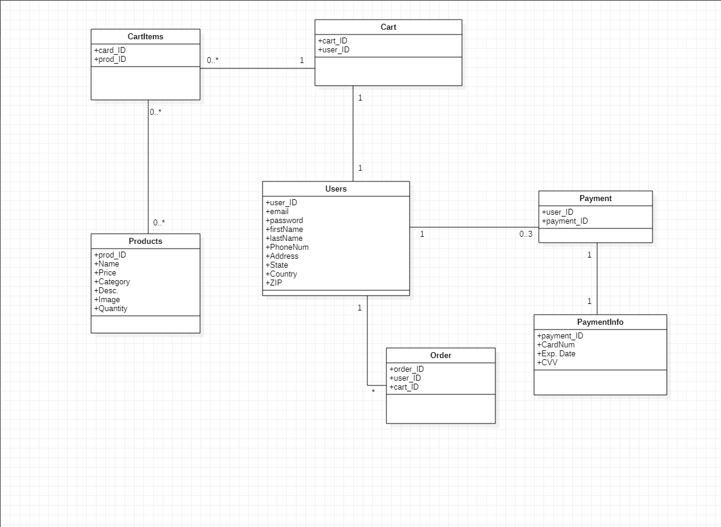
ER Diagram
This is our ER diagram that shows the relationships between each of our tables. It shows the various Cardinalities of the relationships, as well as the columns that are included in each class
Notes:
Kalyb

Slide 6
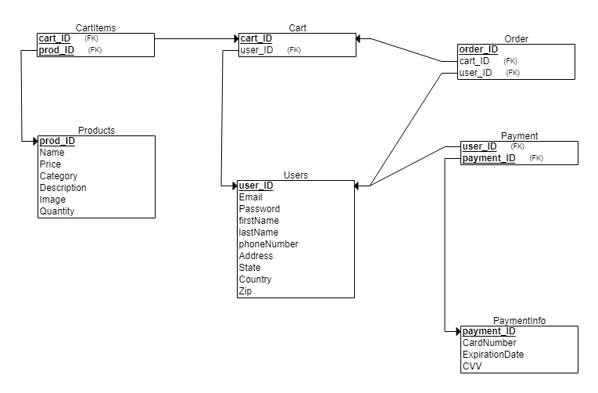
Relational Schema
This is a diagram of our relation schema. It displays the various primary and foreign keys, and the relationship between them in each table.
Notes:
Kalyb

Slide 7
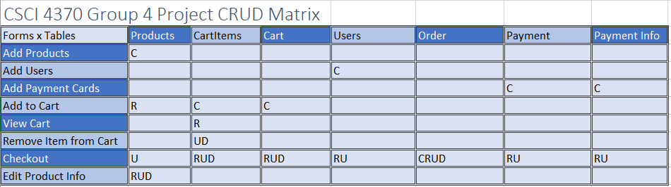
CRUD Matrix: Forms versus Tables
This is our CRUD Matrix that shows the relationships between our tables and forms for the pet store. Specifically it shows the activity and permissions with tables that the form may have.
Notes:
Joseph

Slide 8
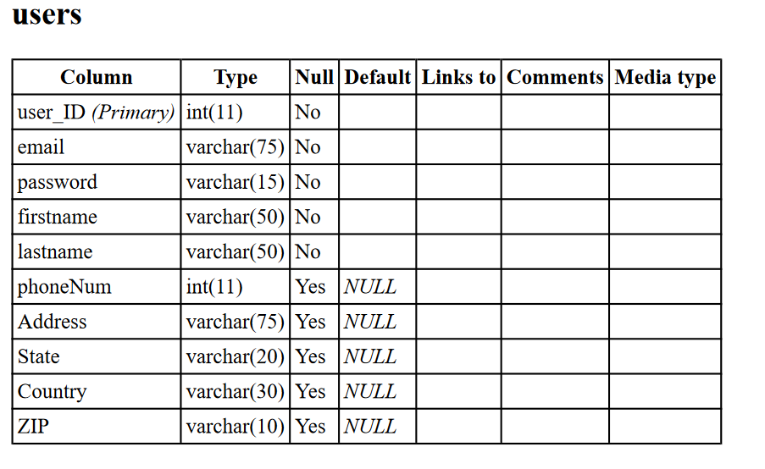
Table Descriptions - Users
One of the main tables of our website is the ‘Users ‘ table. This table is made up of all the user accounts and their corresponding information. This includes email, location, payment info, and more
Notes:
Avranil

Slide 9
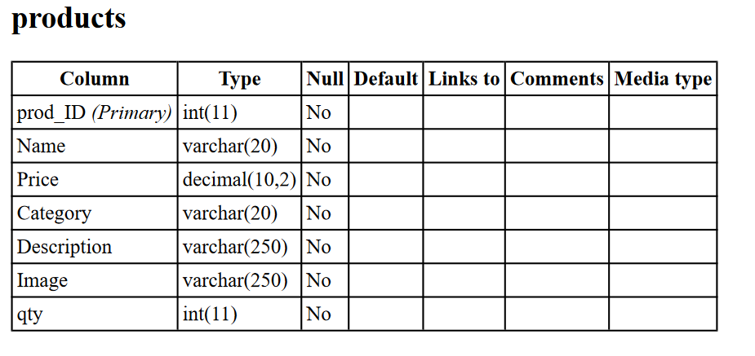
Table Descriptions - Products
The next most populated table is the ‘Products’ table. This table includes the entire catalog of products that are stocked in the store, along with the details that go with each product such as name, price, description picture, etc.
Notes:
Avranil

Slide 10
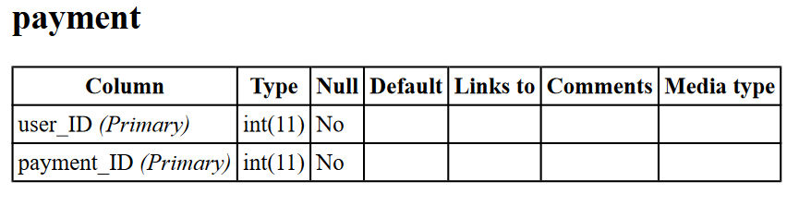
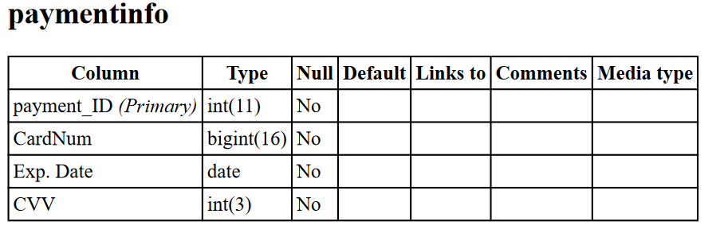
Table Descriptions - Payment & PaymentInfo
The ‘payment’ and ‘paymentinfo’ classes store information about the user’s inputted payment info. The ‘payment’ table first links a userID to a paymentID, and payment info stores the actually info of a specific card. This type of table would allow the owner of the site to allow the users to store multiple cards without much editing to the database
Notes:
Avranil

Slide 11
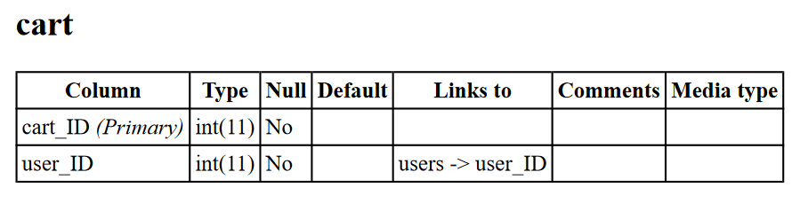
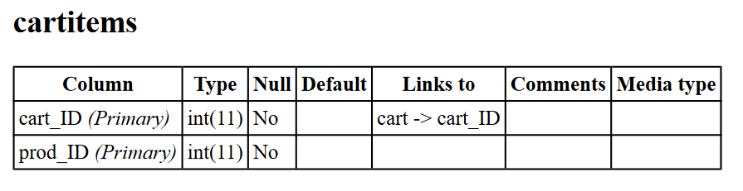
Table Descriptions - Cart & Cartitems
‘Cart’ and ‘Cartitems’ work in a very similar way as payment and payment info. The cart table links a userID to a cardID, and the cartitems table stores the actual items in a specific user’s cart.
Notes:
Avranil

Slide 12
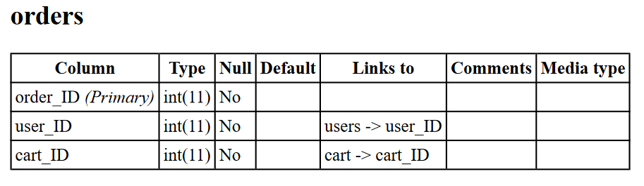
Table Descriptions - Orders
The final table we are using is a orders table. It links userID, and cartID. This allows users to go through their order history and look at past orders for example.
Notes:
Avranil

Slide 13



List of Example Queries
SELECT * FROM Products;
SELECT * FROM Products WHERE Name = ‘Apples’;
SELECT * FROM CartItems WHERE cart_ID = ‘1’;
Notes:
Joseph

Slide 14

List of Example Queries
SELECT * FROM Users WHERE user_ID = ‘1’;
INSERT INTO Products VALUES (1, ‘Carrots’, 1.00, ‘Food’, ‘A Stick of Carrot’, ‘/carrotimage’, 100);
DELETE FROM CartItems WHERE cart_ID = ‘1’;
UPDATE Products SET qty = qty - 1 WHERE prod_ID = ‘1’ AND qty > 0;
Notes:
Joseph

Slide 15
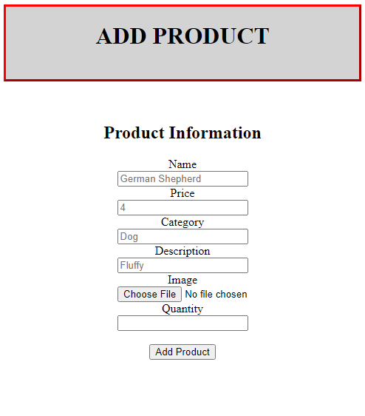
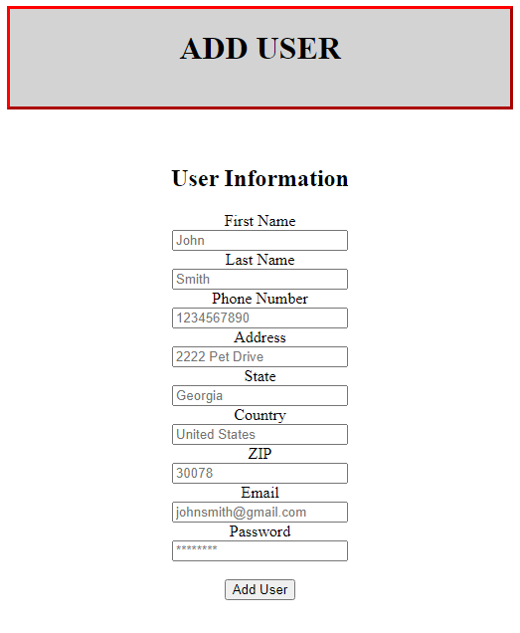
Forms
Notes:
Joseph

Slide 16
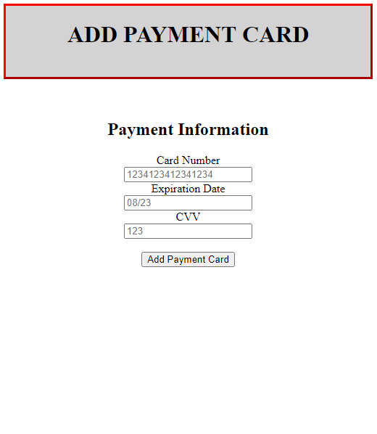
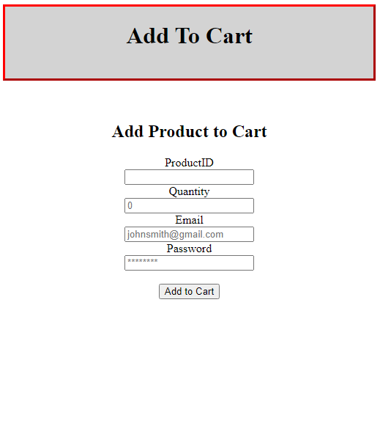
Forms
Notes:
Joseph

Slide 17
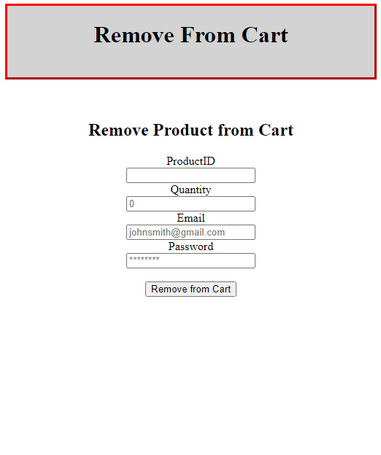
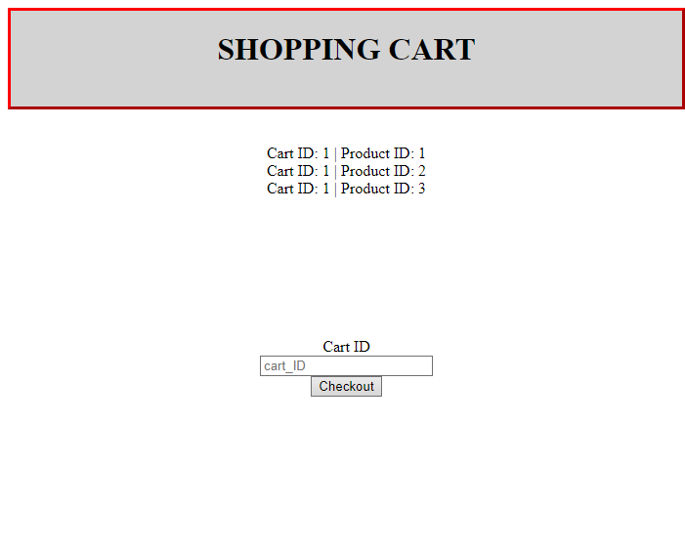
Forms
Notes:
Joseph

Slide 18
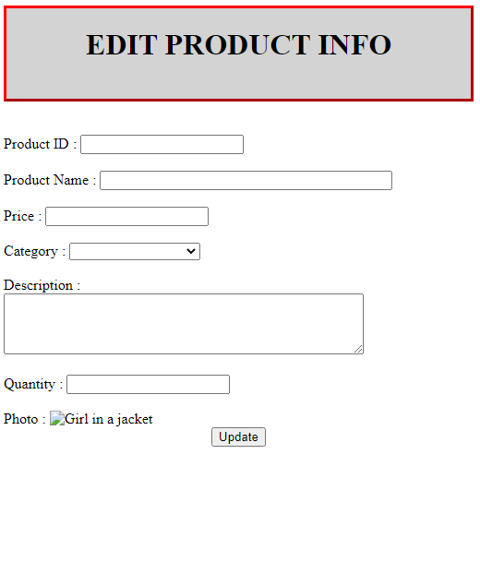
Forms
Notes:
Joseph

Slide 19
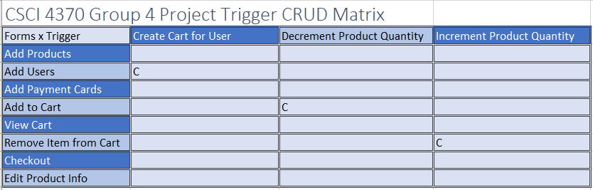
CRUD Matrix: Forms versus Triggers
Notes:
Joseph

Slide 20
Triggers
Trigger 1 - Create Cart for User
This trigger creates a cart for the new user when a new user is added to the database
CREATE TRIGGER `create cart` AFTER INSERT ON `users`
FOR EACH ROW INSERT INTO cart (cart_ID, user_ID)VALUES(new.user_ID,new.user_ID)
Notes:
Reese

Slide 21
Sequence/Triggers/Stored Procedures
Trigger 2 - Decrement Product Quantity
This trigger decrements the qty amount when a product is added to a users cart
CREATE TRIGGER `subtract qty` AFTER INSERT ON `cartitems`
FOR EACH ROW UPDATE products SET qty = qty - 1 WHERE prod_ID = new.prod_ID
Notes:
Reese

Slide 22
Sequence/Triggers/Stored Procedures
Trigger 3 - Increment Product Quantity
This trigger increments the qty amount when a product is removed from their cart
CREATE TRIGGER `subtract qty` AFTER INSERT ON `cartitems`
FOR EACH ROW UPDATE products SET qty = qty + 1 WHERE prod_ID = new.prod_ID
Notes:
Reese

Slide 23
View
Users can view their own personal order history
CREATE THE VIEW
CREATE VIEW userOrders AS
SELECT * FROM orders WHERE user_ID = user_ID;
INVOKE THE VIEW
SELECT * FROM userOrders WHERE user_ID = ‘$user_ID’;
Notes:
Joseph

Slide 24
Problems Encountered and Solutions
We had a few problems with the design of the website:
Problem 1: We couldn’t search for a product and add it.
Solution: We made a simple form where you can add a product to the cart using the product ID.
Problem 2: We had no login feature for the forms to edit user specific data.
Solution: Our forms can specify the user using email.
Problem 3: Implementation of triggers into the database
Solution: Because we had inexperience adding triggers into a database, we used trial and error, as well as online tutorials to add the triggers that we wanted into the database.
Notes:
Kalyb

Slide 25
Demo
Notes:
Joseph/Reese

Slide 26
Questions?
Notes:
Everyone

